Slide 1
Development Environment
Hongfei Yan
School of EECS, Peking University
Sept. 24, 2020

Slide 2
Recap
课程网站：https://pku.instructure.com/
电子版教材、课件，通知，作业，课堂直播地址等信息
编程网站：http://codeforces.com/
上机课说明：
上机课（免费提供的机器使用时间），学生自己安排内容。只有期末的模拟考试，正式考试，有统一安排。
MOOC班同学用自己的电脑练习
期末考试网址：http://cs101.openjudge.cn/cs10120fe/
期末机考时间：2021年1月6日（周三）15:10~17:00；地点是平时上机课机房
MOOC班考试信息，另外通知

Slide 3
Touch Typing Study, https://www.typingstudy.com
The starting position is as follows:
the main keys are F and J.
Find these positions without even looking at the keyboard; feel for the small plastic, elevated 'tabs' on the F and J keys and place your index fingers on those keys.
Place the fingers of your left hand on the keys A, S, D and F and the fingers of your right hand on the keys J, K, L and ;.
This positioning is called 'home row'. Once a key is pressed remember to put your fingers back on the home row.
This will help you to stop looking at the keyboard.

Slide 4
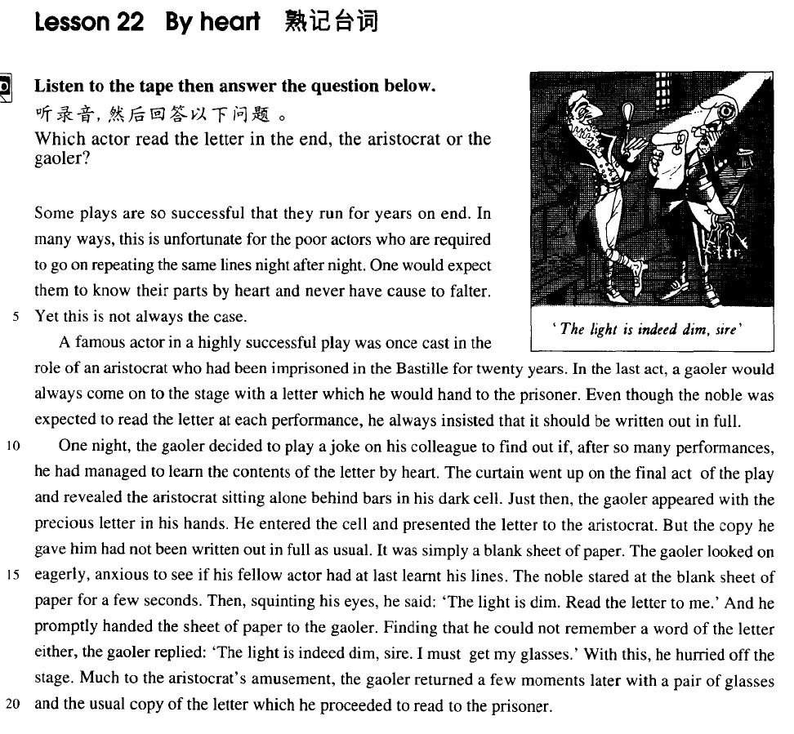
练习盲打： 新概念英语第三册22课 我用了7分40秒

Slide 5
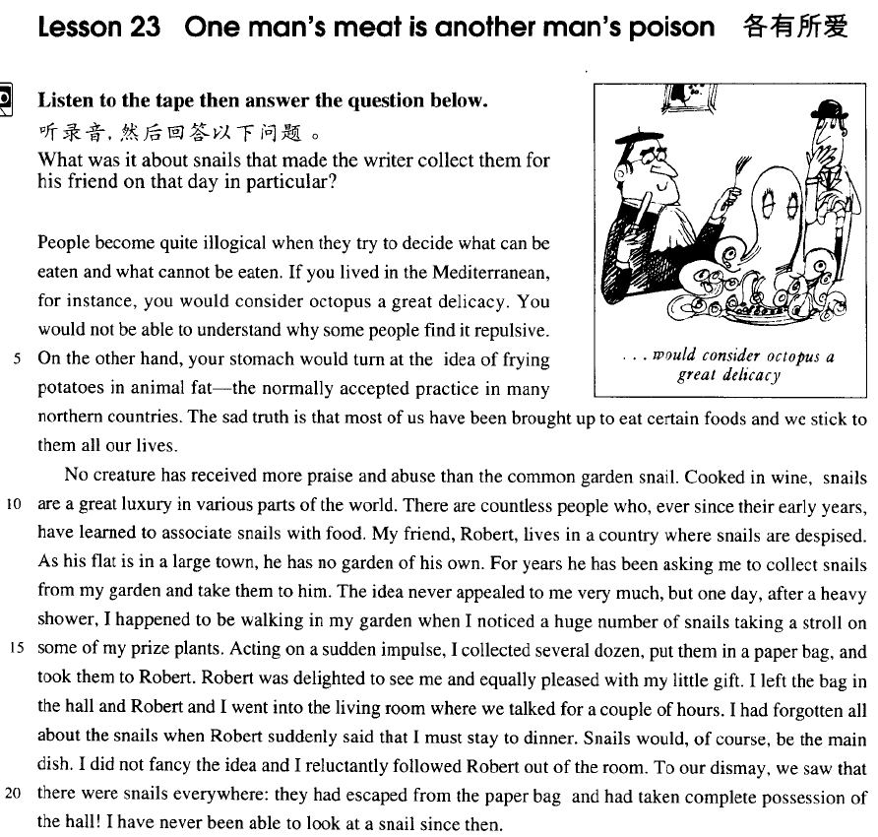
练习盲打： 新概念英语第三册23课 我用了7分34秒

Slide 6
How to submit a problem to CodeForce
How to submit a problem to CodeForces https://www.youtube.com/watch?v=fbNRCXRJ76E
这个2:45的提交程序视频里面选择的是CONTESTS里面的题目，我们直接PROBLEMSET的题目做就可以。
Great Wall of China

Slide 7
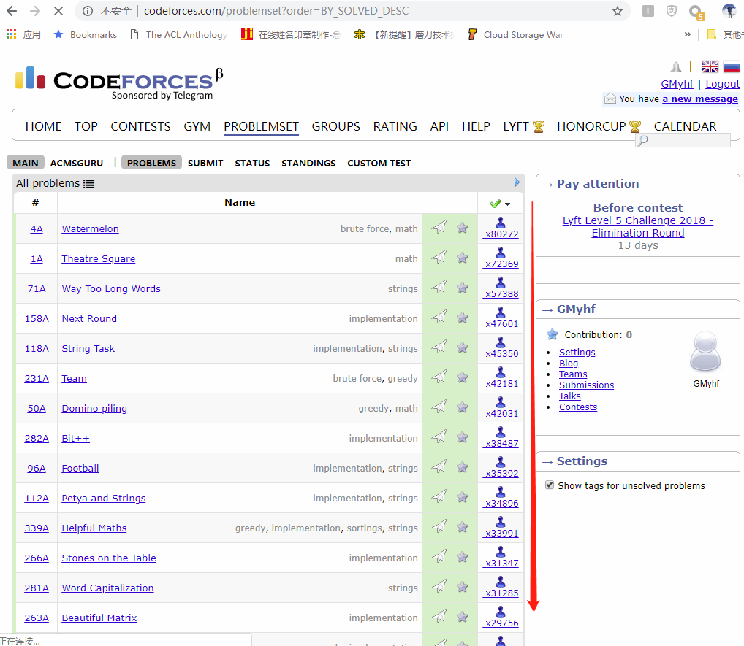

Slide 8
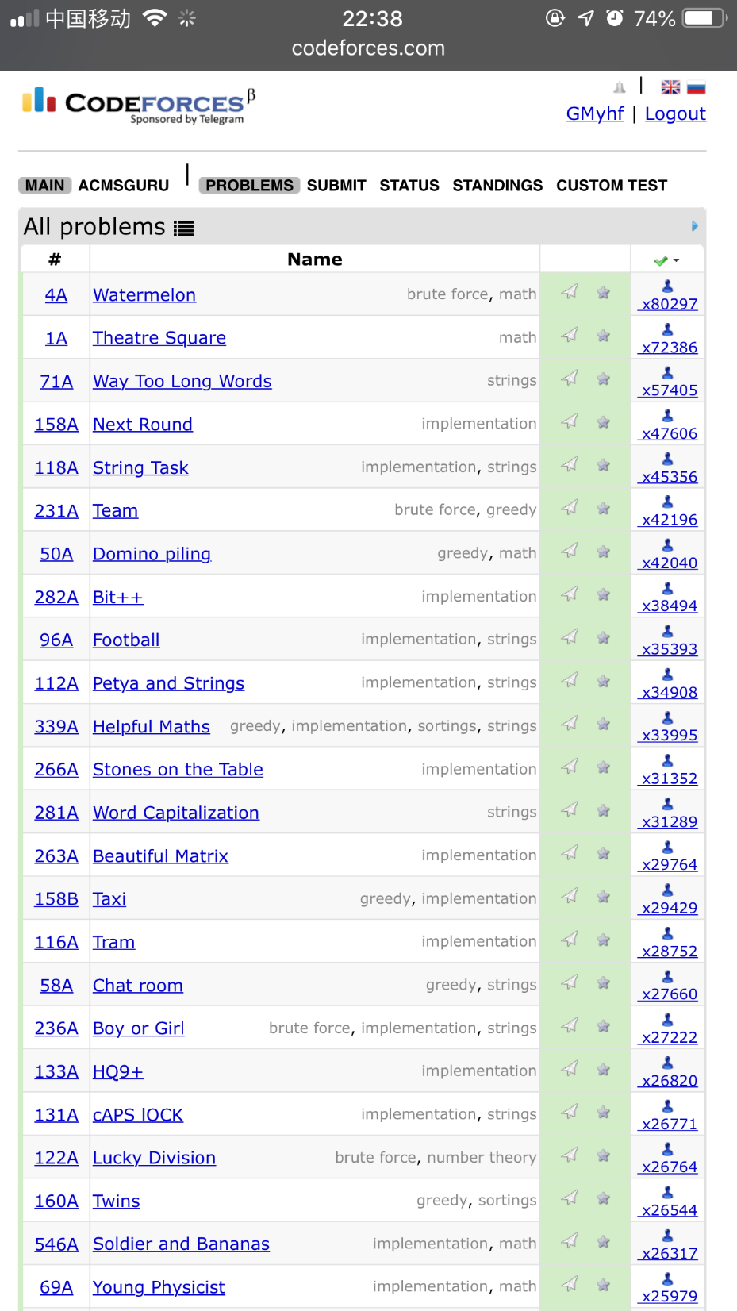
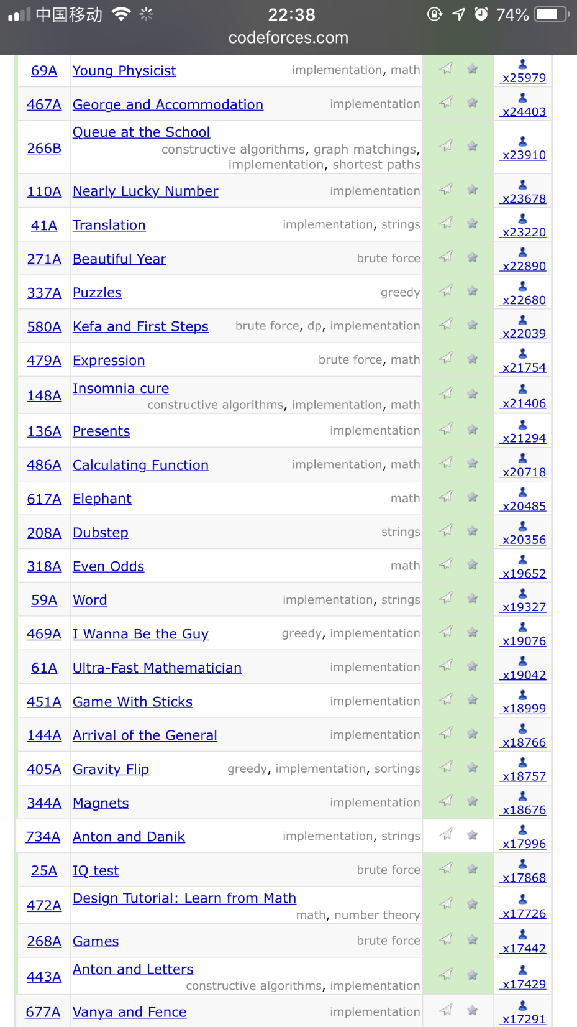

Slide 9
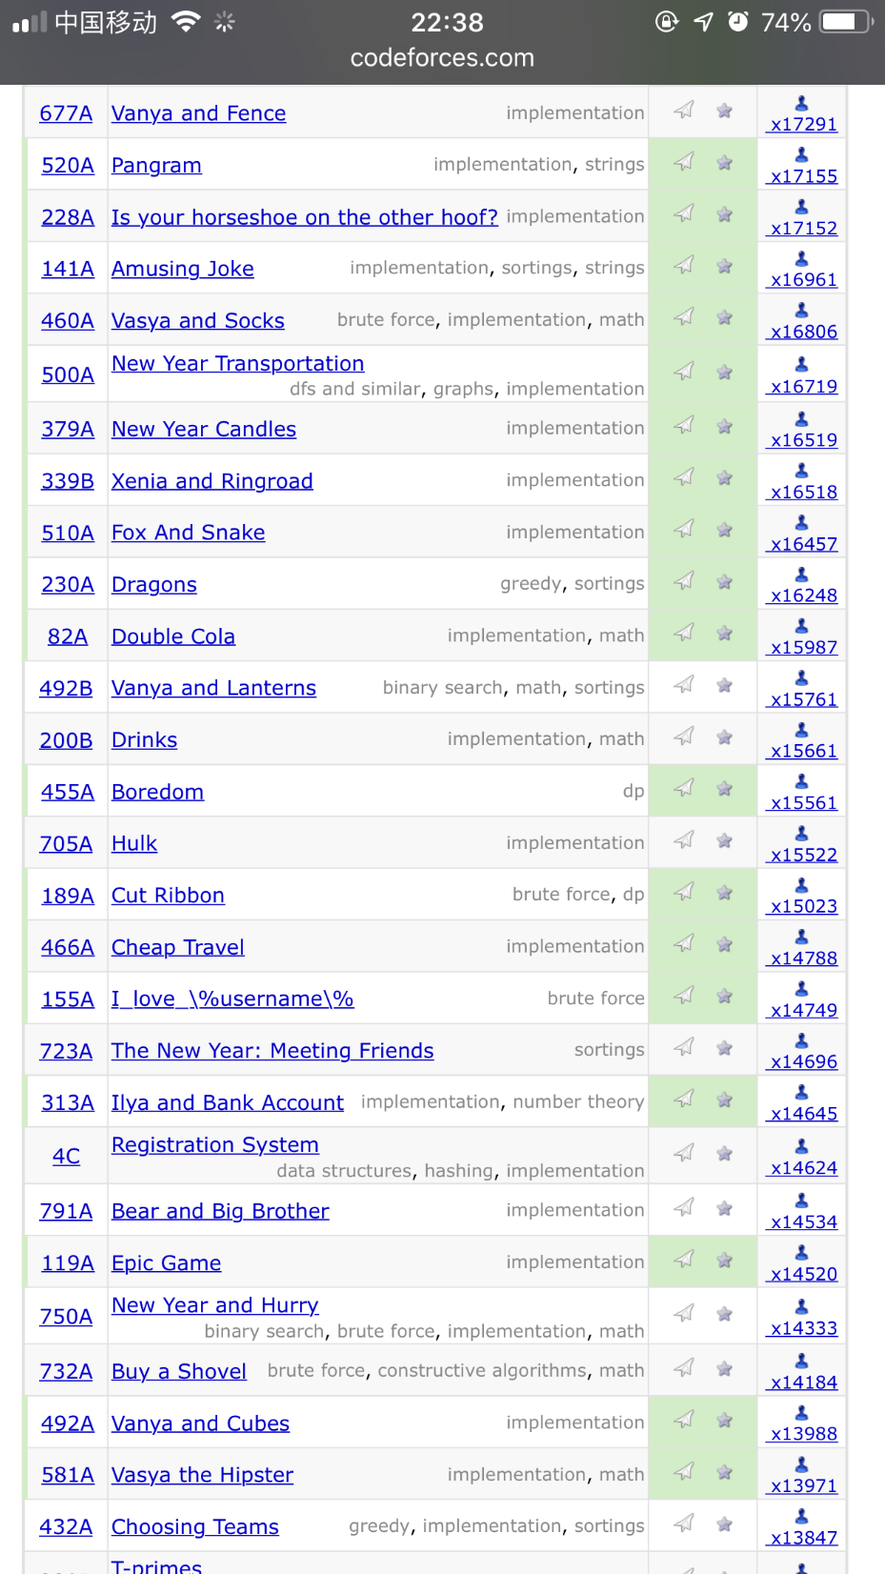
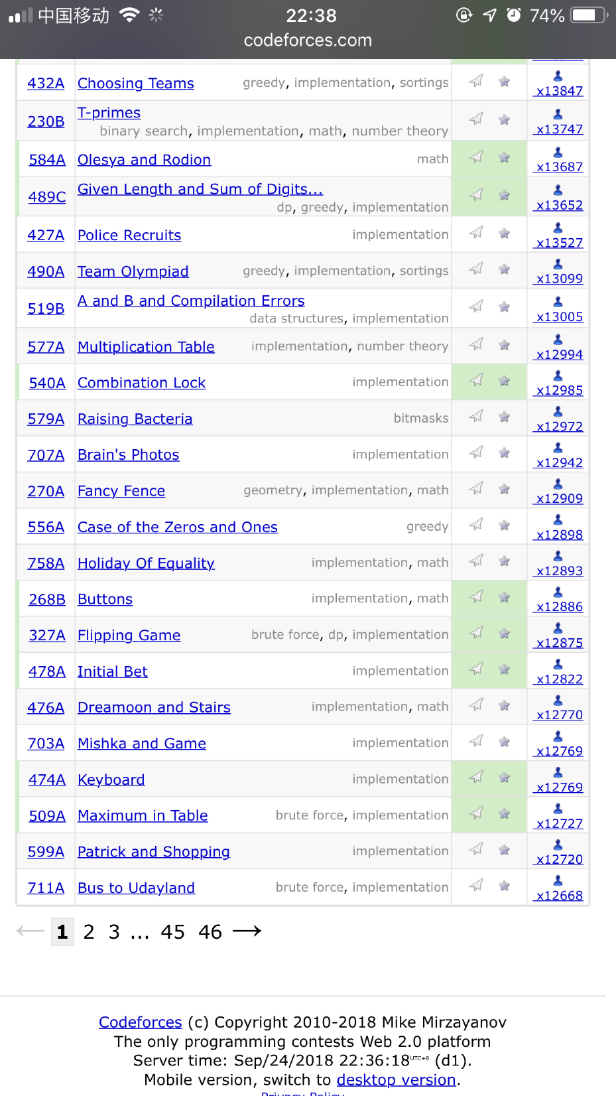

Slide 10
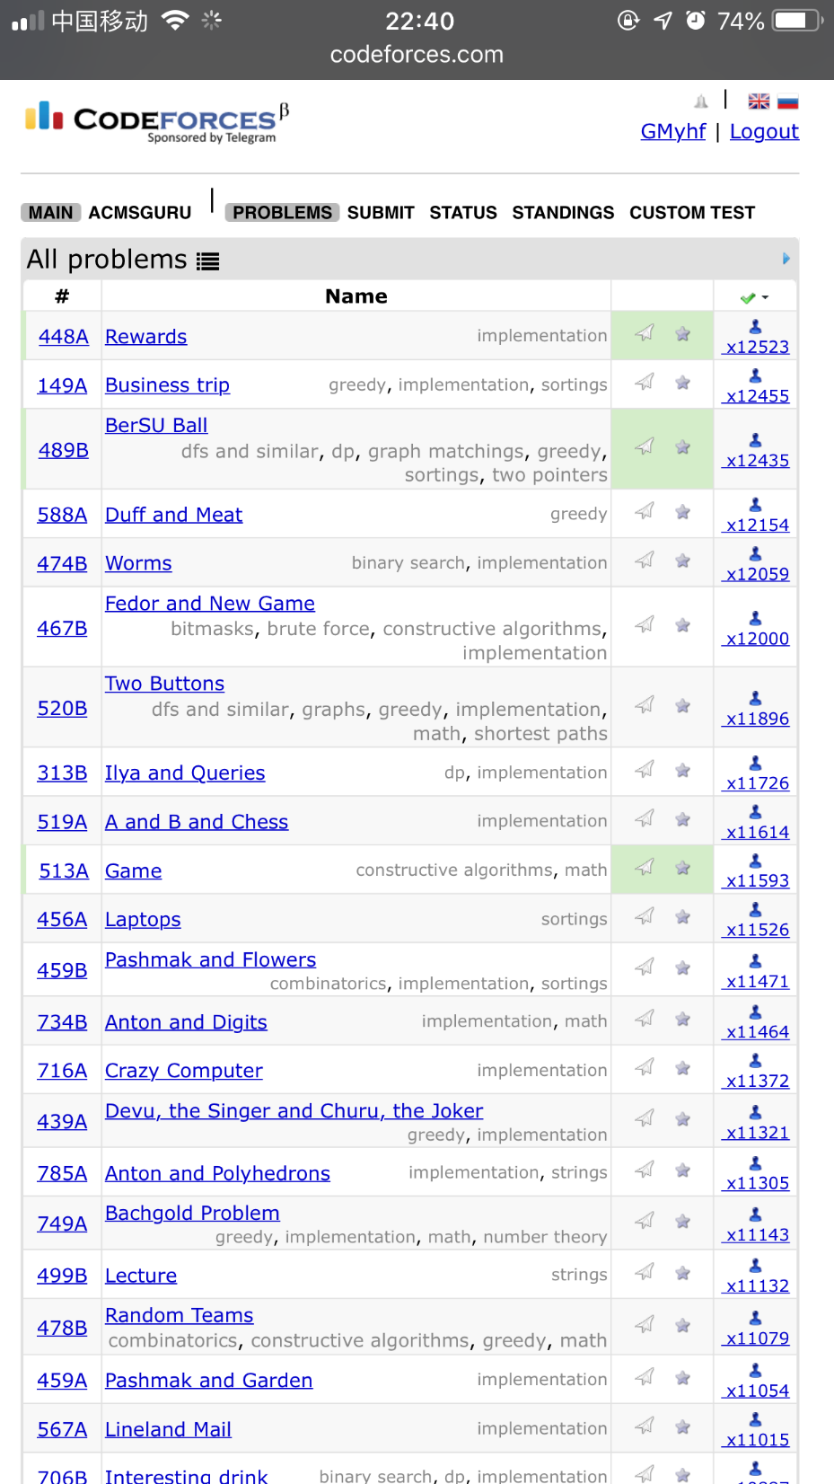
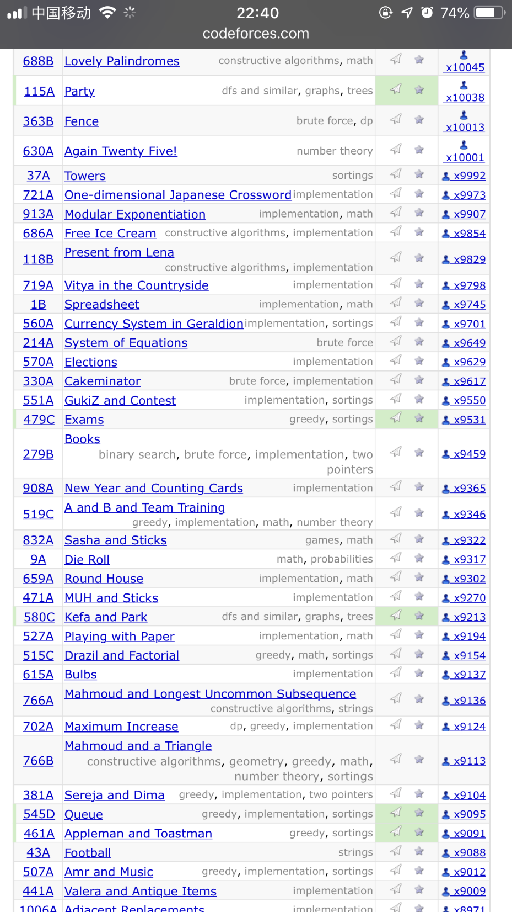

Slide 11
What is Python?
Python is a programming language that is easy to learn, yet powerful and flexible.
Many professional software engineers use Python every day to do their job,
for both large projects and small ones.
Python is free, open source, and it runs on Windows, Mac, and Linux, as well as many other operating systems.
It's a great language if you want to start learning how to write computer programs.

Slide 12
Typical Python Development Environment
Edit
Programmer writes program (and stores source code on disk)
Preprocess
Perform certain manipulations before compilation
Compile
Compiler translates C++ programs into machine languages
Link
Link object code with missing functions and data
Execute
Transfer executable image to memory
Execute the program one instruction at a time

Slide 13
基本概念
在这门课程里主要介绍编写Console Application类型的程序。
这类程序的特点是：
程序运行中会打开一个类似于DOS操作系统的界面，
所有键盘输入都是通过DOS界面进行的，
而所有输出都是输出到DOS窗口中。

Slide 14
Source File（源程序）
源程序是我们用高级程序设计语言书写的程序。
源程序必须经过解释程序才能运行。
我们主要用Python语言编写源程序。
之后留的作业，如果是编程序，同学们需要提交的就是源程序。

Slide 15
Debug（调试）
当程序出错时，可用调试工具发现错处的代码，进行改正。
所谓调试是指逐条执行或部分执行程序代码，并在执行过程中查看变量的值。
当发现变量的值并非如我们预期或程序的执行逻辑并非我们预期时，就发现了错误，可以进行有针对性的改正。

Slide 16
Run（运行）
启动一个可执行程序使其开始执行称为运行。

Slide 17
Contents
Python on Windows
Python on Mac

Slide 18
Installing Python
Go to python.org and download the version of Python that you want.
In these examples, I'm downloading Python 3.7.0.
Run the installer, and let it install to the default location: in this case, C:\Python37\

Slide 19
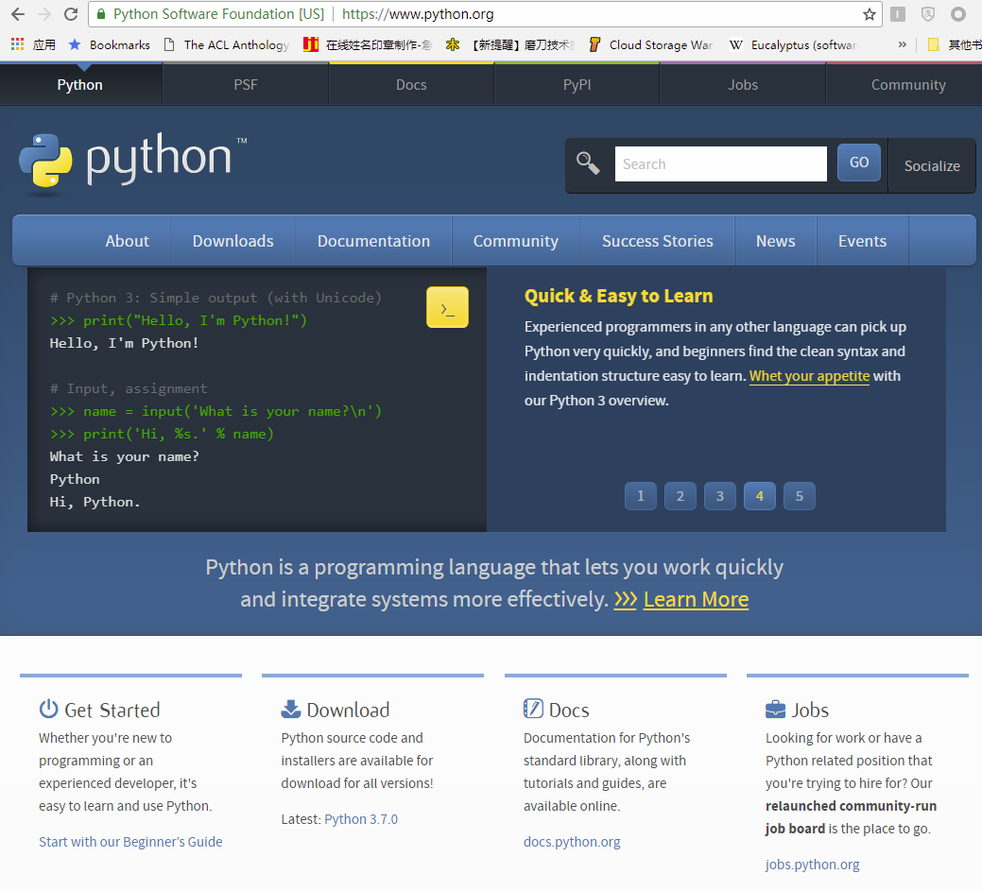

Slide 20
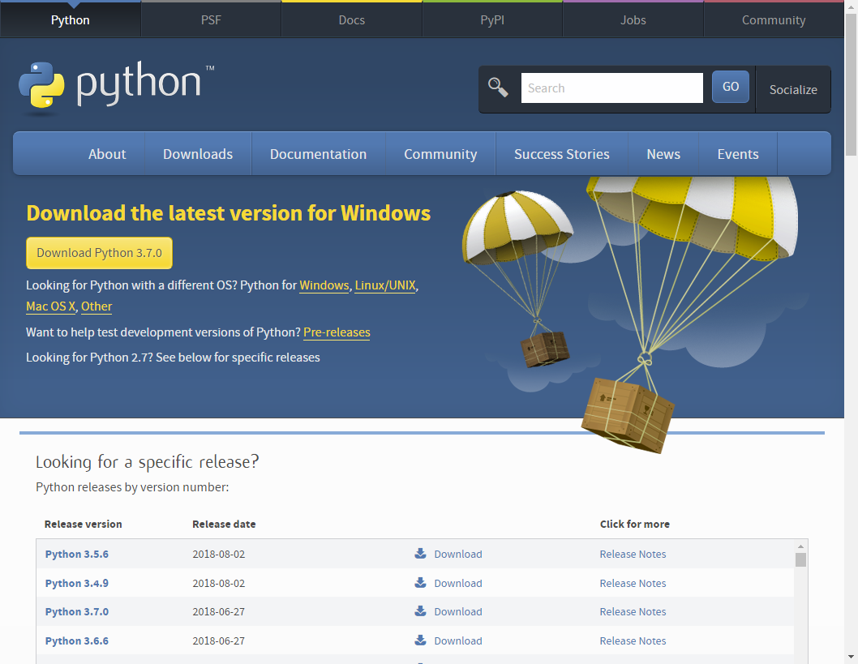

Slide 21
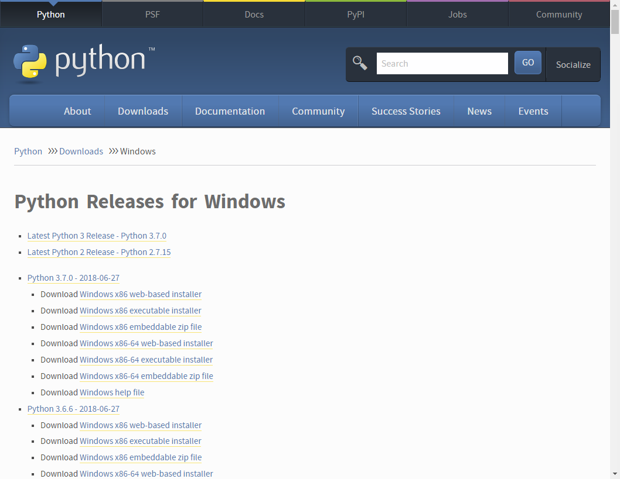
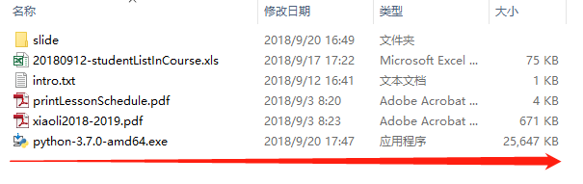

Slide 22
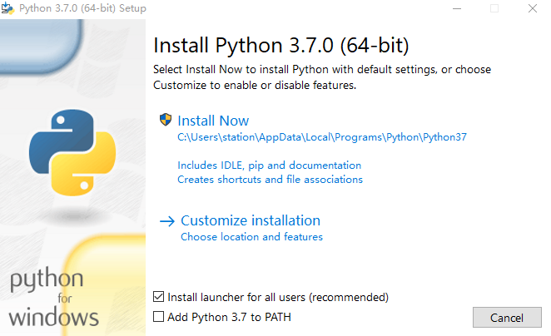

Slide 23
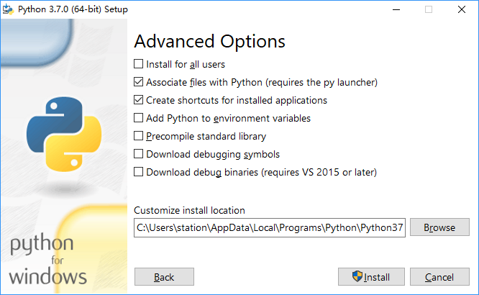
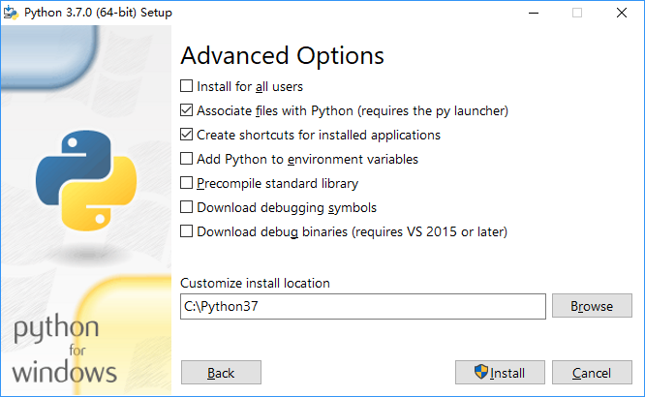

Slide 24
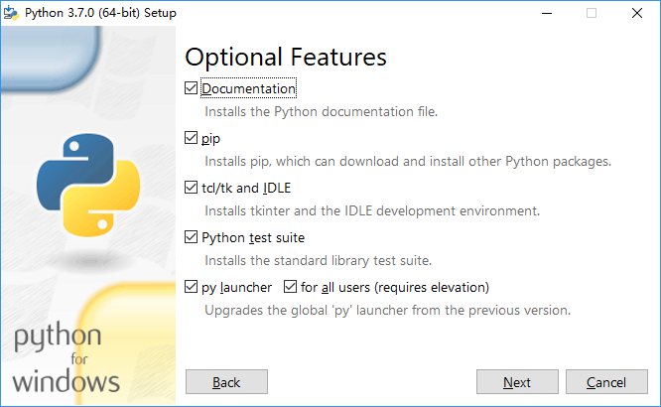

Slide 25
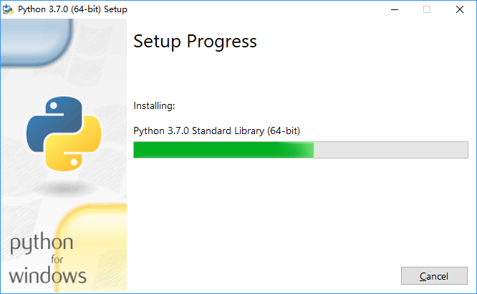
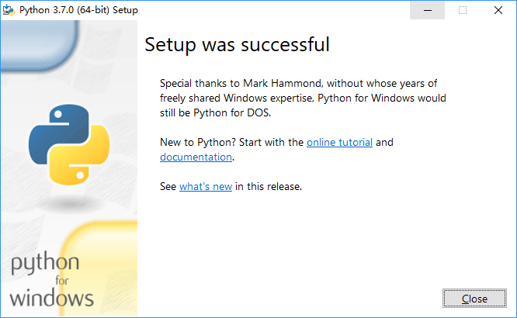

Slide 26
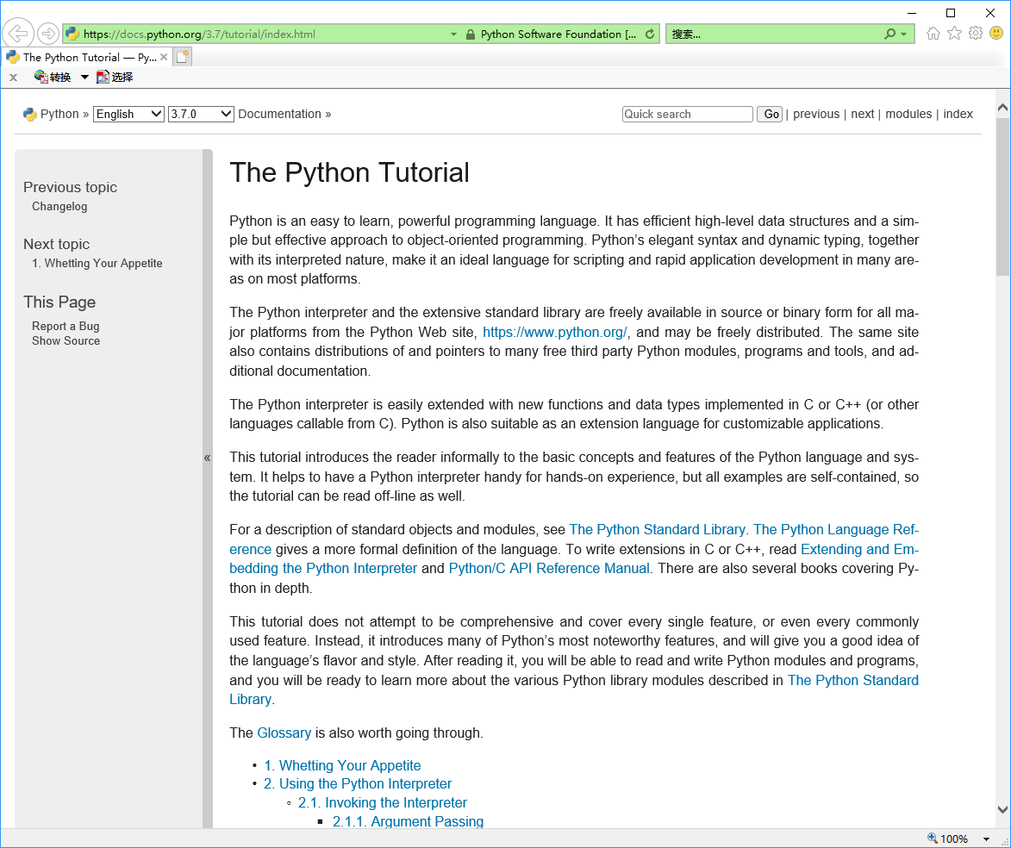
Notes:
https://docs.python.org/3.7/tutorial/index.html

Slide 27
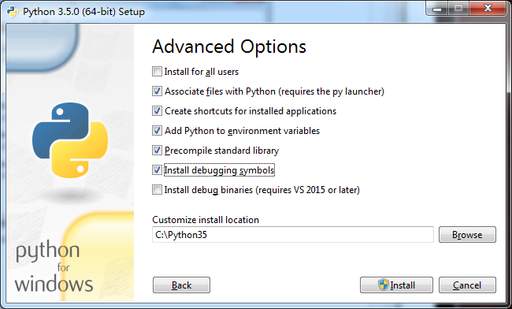

Slide 28
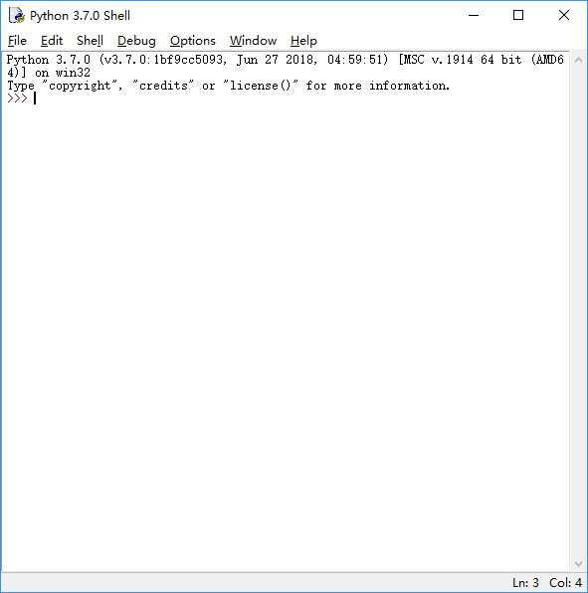
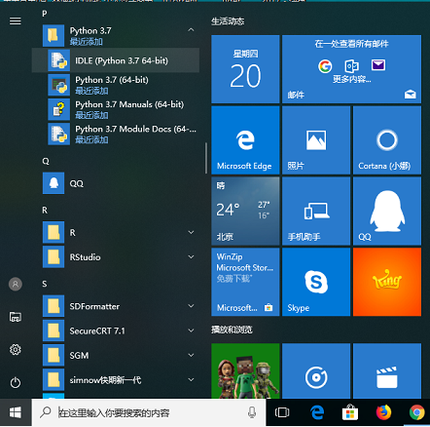
Notes:
IDLE is Python’s Integrated Development and Learning Environment.

Slide 29
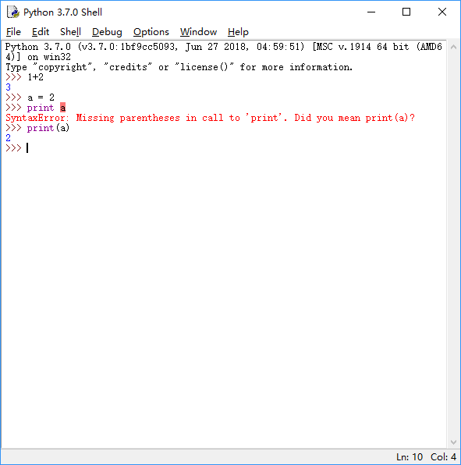

Slide 30
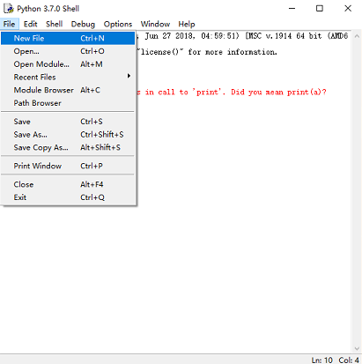
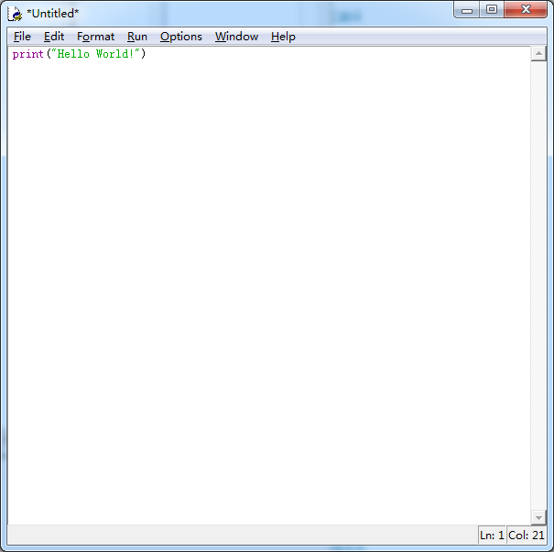
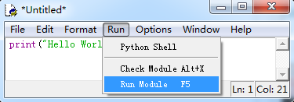
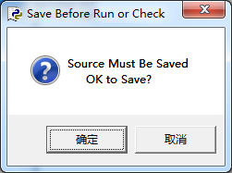
可以在IDLE环境中直接运行
Notes:
IDLE has two main window types, the Shell window and the Editor window.

Slide 31
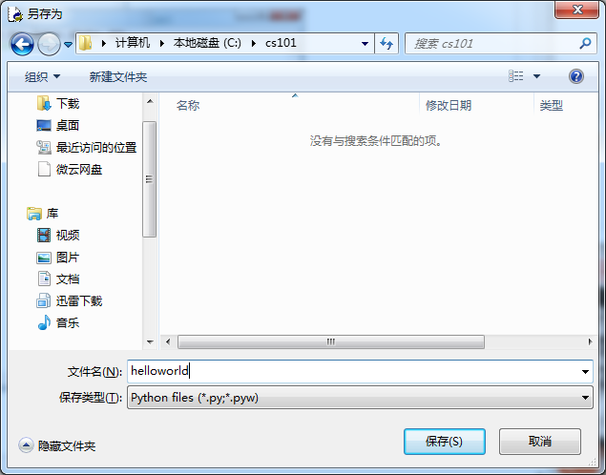
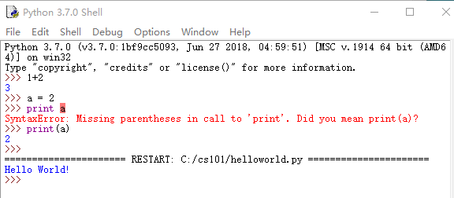

Slide 32
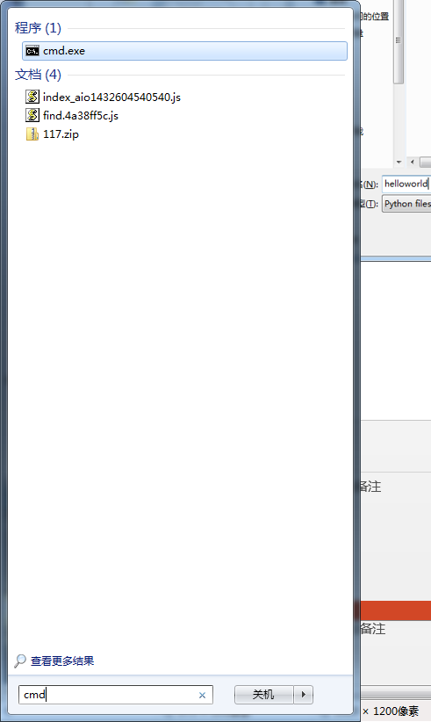
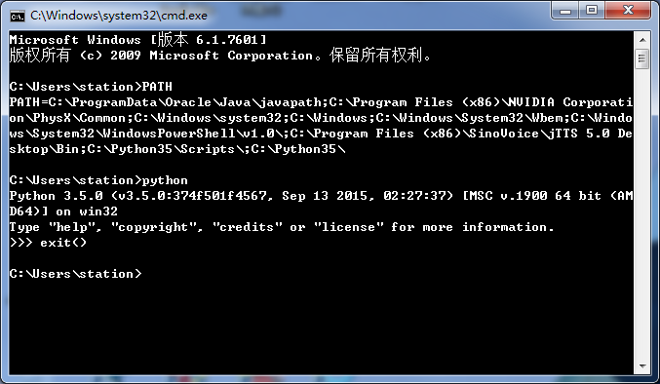
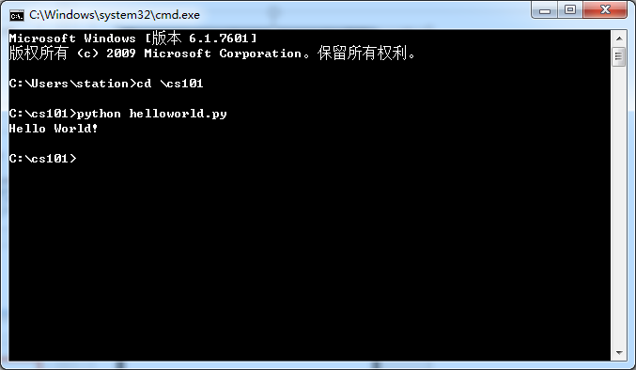
也可以在DOS下的command窗口运行

Slide 33
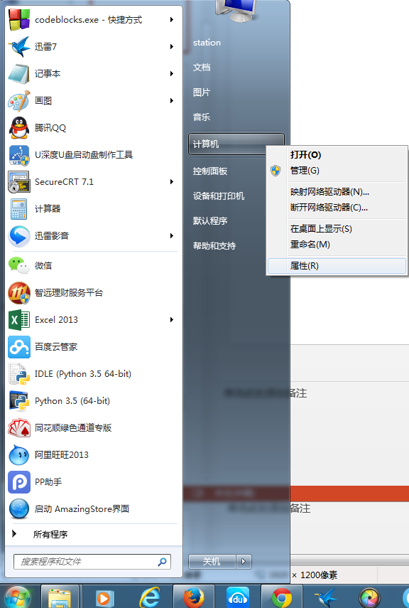

Slide 34
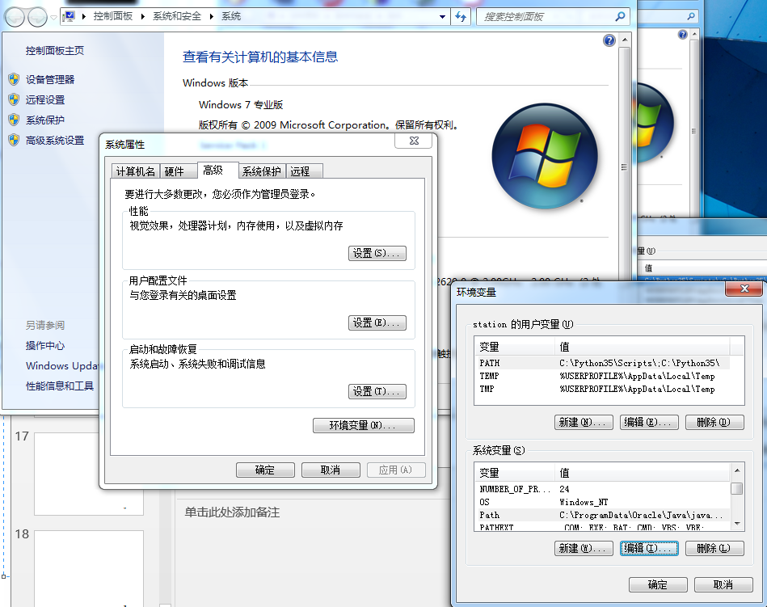

Slide 35
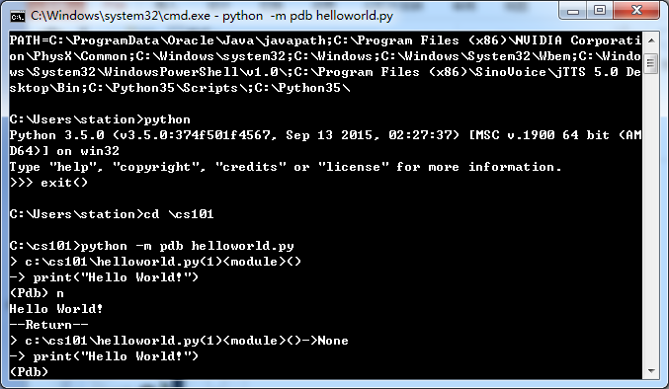
Debug python –m pdb helloworld.py

Slide 36
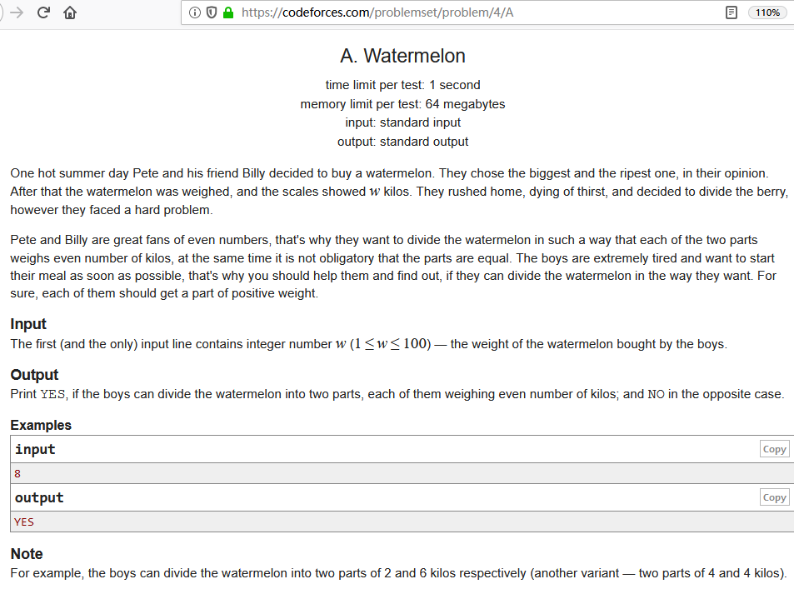

Slide 37
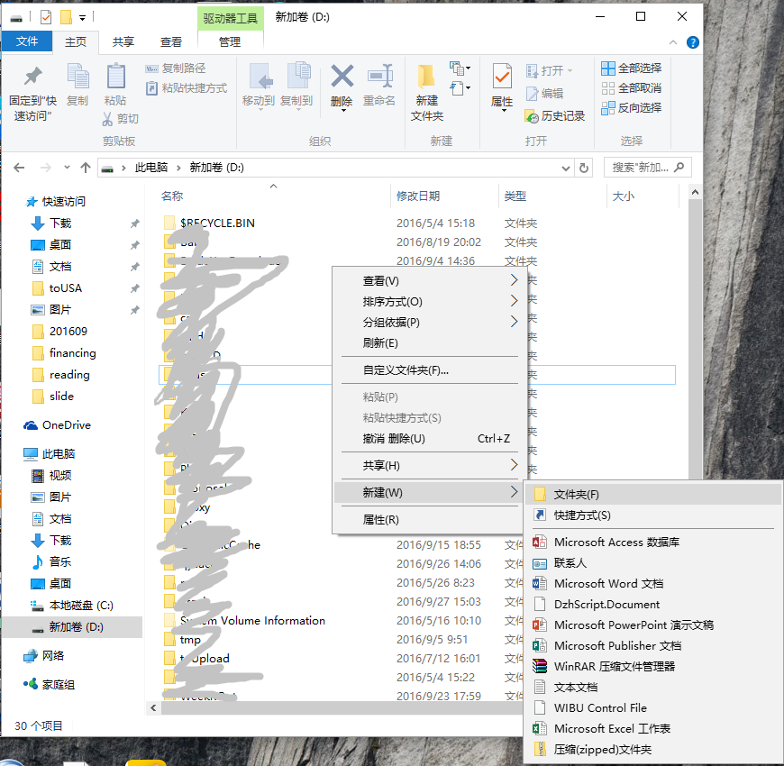
Notes:
选择一个磁盘，如“新加卷(D:)”，压右键，选择“新建”，在向右弹出的下拉菜单中选择“文件夹”

Slide 38
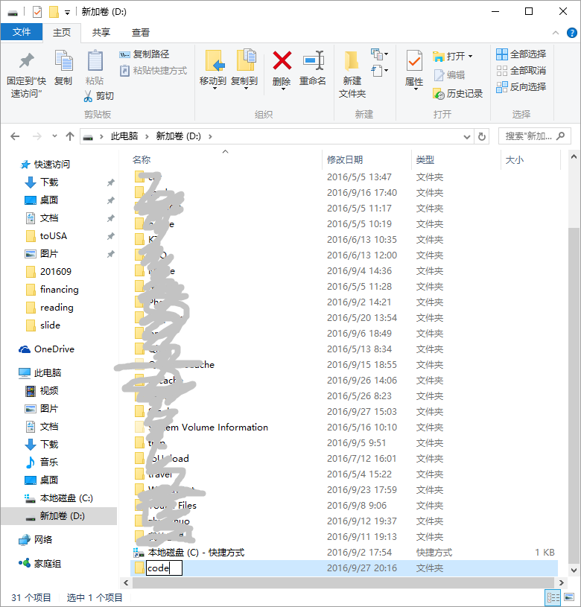

Slide 39
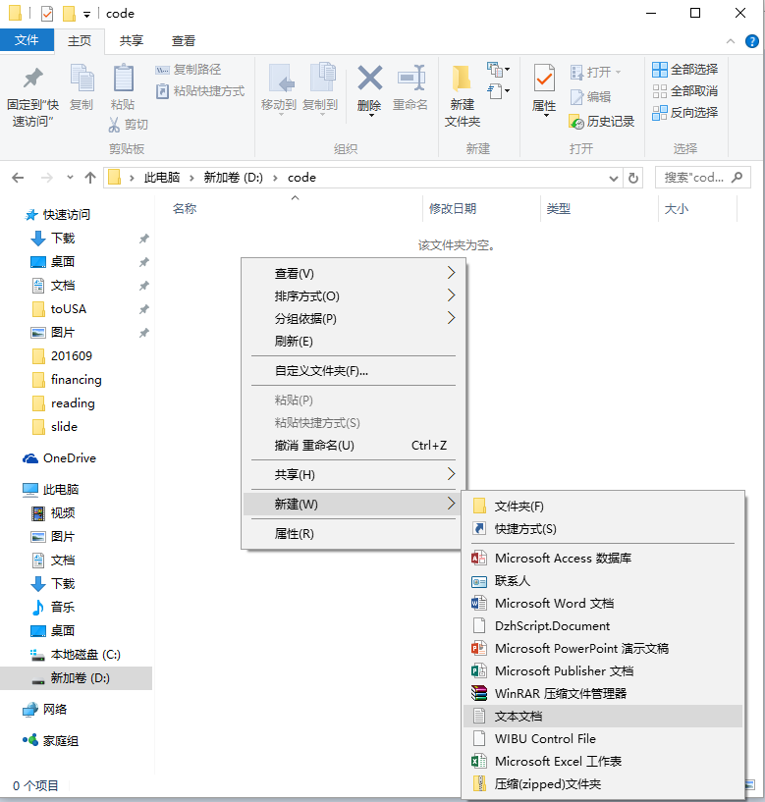

Slide 40
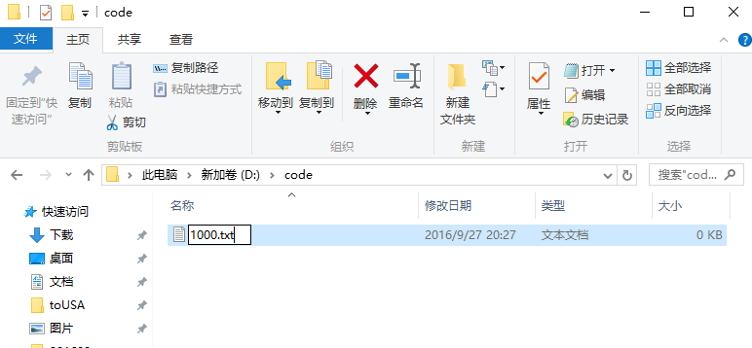
4A.txt

Slide 41
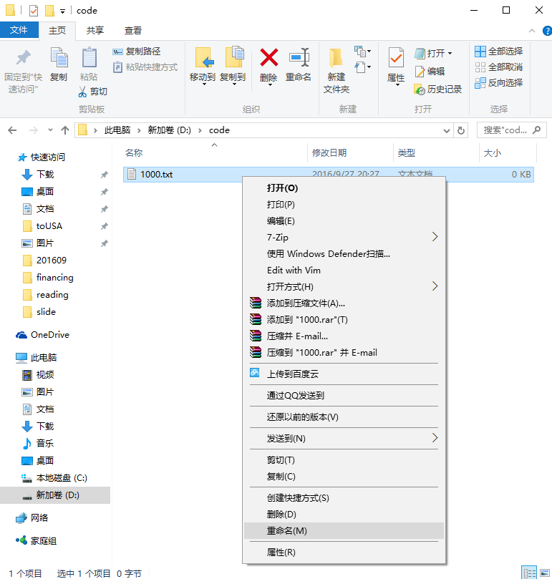
4A.txt

Slide 42
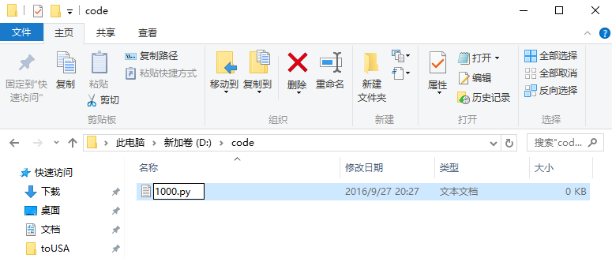
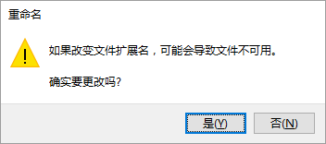
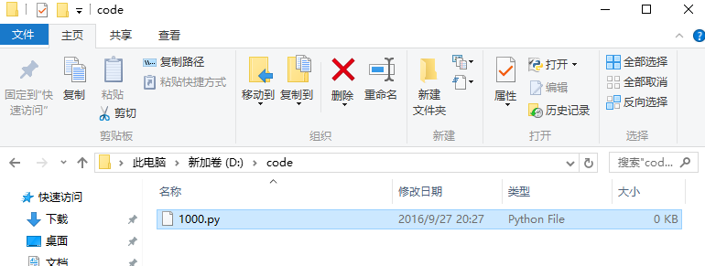
4A.txt
4A.py

Slide 43
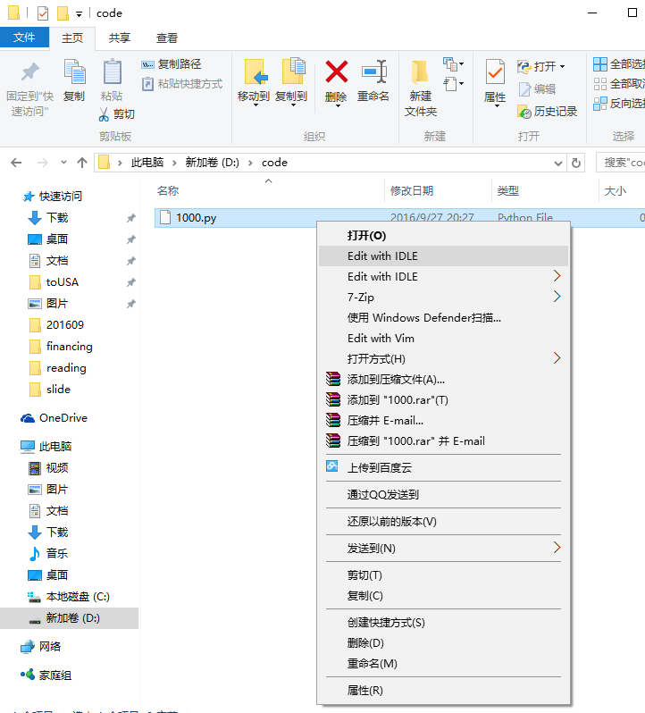
4A.py

Slide 44
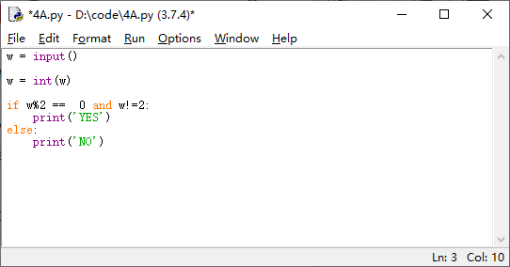
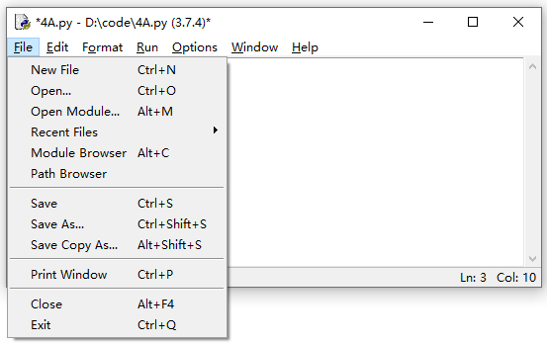
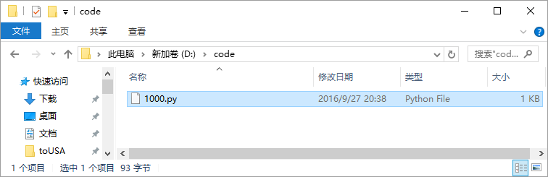
4A.py

Slide 45
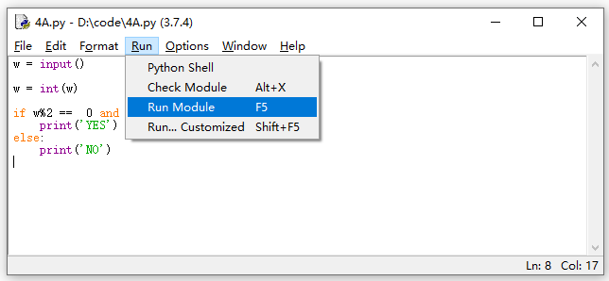




Slide 46


Slide 47


Slide 48
Linux 下的 Python
多数 Linux 发行版也都自带 Python。如果没有，可以按照下面命令安装。
$ sudo apt-get install python3 或者
$ sudo yum install python3
在 Terminal 下可以通过
$ python *.py 来运行 Python 2 程序，或者
$ python3 *.py 来运行 Python 3 程序。

Slide 49
Contents
Python on Windows
Python on Mac

Slide 50
The way to install software on OSX
visit https://www.macports.org
choose "Available Ports", and search your software, such as "python35".
the command-line installation,"sudo port install python35".
Notes:
HF Yan
http://divvun.no/doc/infra/GettingStartedOnTheMac.html
Basic programming tools (in this order):Xcode
MacPorts
https://www.macports.org/install.php
为了安装port，先要安装xcode，为了xcode先要升级OS X
在Apple Store中查找OS X，升级系统到 OS X EI Capitan。需要下载6.71GB
然后安装xcode，4.43GB
xcode-select –install
MacPorts-2.3.4-10.12-Sierra.pkg
sudo port –v selfupdate
xcode-select –install
To make this the default Python or Python 3 (i.e., the version run by the ‘python’ or ‘python3’ commands), run one or both of:
sudo port select –set python python35
sudo port select –set python3 python35

Slide 51
https://www.macports.org/install.php
为了安装port，先要安装xcode，为了xcode先要升级OS X
在Apple Store中查找OS X，升级系统到 OS X EI Capitan。需要下载6.71GB
然后安装xcode，4.43GB
xcode-select –install
MacPorts-2.3.4-10.12-Sierra.pkg
sudo port –v selfupdate
xcode-select –install
To make this the default Python or Python 3 (i.e., the version run by the ‘python’ or ‘python3’ commands), run one or both of:
sudo port select –set python python35
sudo port select –set python3 python35

Slide 52


Slide 53


Slide 54


Slide 55


Slide 56


Slide 57


Slide 58


Slide 59


Slide 60


Slide 61


Slide 62


Slide 63


Slide 64


Slide 65


Slide 66


Slide 67


Slide 68


